Slide 1
MEEG333 FLUIDS LAB
Objectives:
Illustrate physical concepts of Fluid Mechanics
developed in class
Learn basic experimental methods for fluids
Connect principles to realistic design problems
Teamwork
Concise report writing, as if to real employer

Slide 2
MEEG333 FLUIDS LAB
Six lab experiments during the semester
One every two weeks for an individual
Team scheme 4-6 people/team
One report per team, due before the next lab
What team am I on?

Slide 3
How team scheme works
A1
Do X1 1st week
A
A2
Do X1 1st week
B
Do X1 2nd week
Each Section
split into A & B
@10-12 each
5-6 each
Each person will have a lab every
two weeks with your team.
@110 enrolled
Total
Five sections
@ 20-25 each
(Day & time)

Slide 4
Where is the Fluids Lab located?
In Spencer 123
(Across hall from M.E. Office)

Slide 5
Lecture Schedule, Wednesdays 3:35 – 4:30
Date Topic
29-Aug Organization; Report formats; Lab X1
12-Sep Lab X2; Uncertainty analysis
26-Sep Lab X3
10-Oct Lab X4
24-Oct Lab X5
7-Nov Lab X6
5-Dec Final (at Lab Disc period)

Slide 6
The semester schedule is posted on Canvas, & lab door
 | Week 1 | Week 2 | Week 3 | Week 4 | Week 5 | Week 6 | Week 7 | Week 8 | Week 9 | Week 10 | Week 11 | Week 12 | Week 13 | Week 14
 | 9/3-7 | 9/10-15 | 9/17-21 | 9/24-28 | 10/1-5 | 10/8-12 | 10/15-19 | 10/22-27 | 10/29-11/2 | 11/5-9 | 11/12-16 | 11/19-23 | 11/26-11/30 | 12/3-7
Lab Team |  |  |  |  |  |  |  |  |  |  |  | TG |  | All rpts
A1 |  | X1 | X2 |  | X3 |  | X4 |  | X5 |  | X6 | TG |  | due
A2 |  | X1 | X2 |  | X3 |  | X4 |  | X5 |  | X6 | TG |  | 8-Dec
B1 |  | X1 |  | X2 |  | X3 |  | X4 |  | X5 |  | TG | X6
B2 |  | X1 |  | X2 |  | X3 |  | X4 |  | X5 |  | TG | X6
 | NOTE: | Monday 9/3 is Labor Day. Monday A1 & A2 will combine with B's on Monday 9/10
 | NOTE: Lab reports are due two weeks after your lab, when you report for the next lab

Slide 7
Labor Day is next Monday. No classes/ no labs.
What to do if you are scheduled for a Monday Lab?
Monday lab teams A1 and A2 are affected. Wed labs are not.
Special case one-time only.
Go to lab the following Monday: Sept 11
B1 & B2 teams will also be there!
B1 & B2 teams report at scheduled times (10:10a, 11:55a, 3:35p)
A1 & A2 teams report @ 30 min later (e.g, 10:45, 12:30p, 4:00p)

Slide 8
Grading
Primarily, based on Reports:
Format followed?
All sections completed?
Data analysis, including uncertainty, correct?
Solution to Design Objective question correct?
Overall appearance
All members of a team share the report grade
Final quiz based on principles taught in the six labs.
An individual’s final grade is average of ( 6 team grades + final grade)

Slide 9
 | Section
 | Team
 | Experiment
 | Report Parts
 |  | Value | Pts given | Comment
1 | Title Page complete | 0.5 |  | Include Sect/Team/Roles
2 | Objectives listed | 0.5 |  | Short
3 | Summary | 0.5 |  | Design Obj results*
4 | Theoretical Background | 0.5 |  | Short
5 | Equipment Diagram | 0.5 |  | Photo okay if labeled
6 | Procedure Summary | 0.5 |  | Short
7 | Results Detail
 | Raw Data attached* | 0.5 |  | And initialed by TA
 | Graphs or charts | 0.5 |  | Clearly labeled
 | Example calculation** | 0.5 |  | At least one case
8 | Uncertainty analysis | 1 |  | As required
9a | Data Analysis | 1.5 |  | Calculation accuracy
9b | Discussion & Conclusions | 1 |  | Related to experiment
10 | Design Objective | 2 |  | Analysis & result
 | Decimal round-off (-.5)
 | Late penalty ( -0.5/day)
 | Absences (-0.5) |  |  | (individual)
 | Data Sheet not prepared(-0.5)
 | Total | 10 | 0

Slide 10
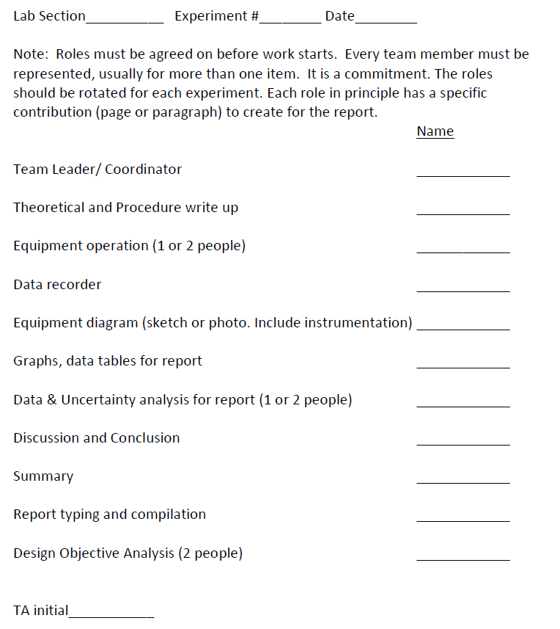

Slide 11
Title Page
Title of Experiment
GroupID
Names of group members and role in this experiment
Date experiment was performed
Date report submitted
Objectives (will be provided by instructor and in handout)
Summary (Suggest: Write this LAST)
Briefly summarize results, corresponding to the Design Objectives,
as if reporting to an employer. Letter Format (Suggest: Write this last!)
Theoretical background
What principle(s) underlie this experiment
Any relevant equations

Slide 12
Equipment
Schematic diagram with all parts labeled and dimensioned
Show measurement devices and instruments (as required).
Copying sections of another report or sharing sketches
with other groups is not permitted.
Photographs are acceptable, provided they are captioned
and key parts labeled.
Provide a definition of all symbols used, including dimensional units..

Slide 13
Procedure
Short version. Don’t copy the instructions again
Results
Key data in tabular form
If data reduction required, show sample calculation
Can use Excel, MathCad or similar for tables and graphs
All graphs should be captioned and axes labeled
Uncertainty analysis as specified in instructions
Discussion and Conclusions
Discuss the experiment, not the Design Objective.
Did apparatus work right (or not)? Why didn’t data match theory?
Design Objective – Answer the question
Appendices – attach copy of raw data sheet

